Slide 1
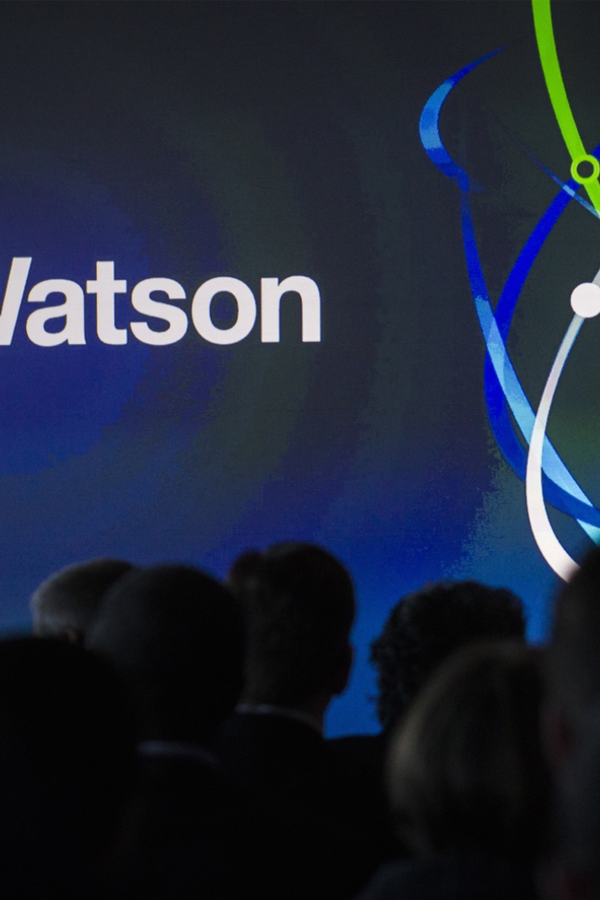
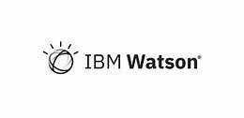
Introduction To WATSON By IBM
Presented by :- Ankit Tiwari

Slide 2
What is Watson?
IBM Watson is a set of artificial intelligence (AI) services and technologies developed by IBM. It is named after IBM's first CEO, Thomas J. Watson. Watson gained widespread attention in 2011 when it competed and won the Jeopardy! quiz show against human champions.
Watson is not a single product but rather a collection of various AI technologies and services that leverage machine learning, natural language processing, and other advanced analytics capabilities. These technologies are designed to process and analyze large amounts of unstructured data, such as text, images, and audio, to provide insights, answer questions, and make data-driven predictions.

Slide 3
Technologies Used By Watson
Image Recognition: Watson uses deep learning techniques, including convolutional neural networks (CNNs), for image recognition. This allows Watson to analyze and understand the content of images, identify objects, and recognize patterns within visual data. Applications of image recognition in Watson include healthcare (e.g., medical image analysis), manufacturing (quality control), and various other industries.
Speech Recognition: Deep learning is employed for speech recognition in Watson. Recurrent neural networks (RNNs) and other deep learning architectures are used to transcribe spoken words into text accurately. This functionality is essential in applications such as virtual assistants, customer service bots, and other voice-enabled systems.
Natural Language Processing (NLP): Deep learning plays a crucial role in the natural language processing capabilities of Watson. Recurrent neural networks and transformer architectures, like BERT (Bidirectional Encoder Representations from Transformers), are used for tasks such as language understanding, sentiment analysis, and language translation. This enables Watson to comprehend and respond to human language in a contextually relevant manner

Slide 4
Anomaly Detection and Predictive Analytics: In various industries, Watson employs deep learning models for anomaly detection and predictive analytics. Deep neural networks can learn complex patterns and relationships within large datasets, making them suitable for identifying anomalies or making predictions based on historical data.
Generative Models: Some implementations of Watson may use generative models, such as generative adversarial networks (GANs) or transformer-based models, for tasks like content generation or creative applications. These models can generate realistic images, text, or other types of content based on the patterns they've learned from training data.
Recommendation Systems: Deep learning models, including collaborative filtering and neural collaborative filtering, are used in recommendation systems within Watson. These models learn user preferences and behavior patterns to provide personalized recommendations in areas like content streaming, e-commerce, and more.

Slide 5
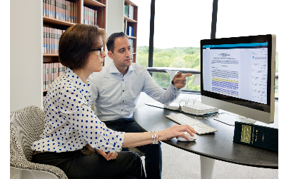
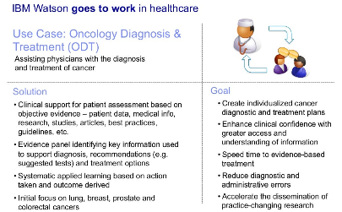
Applications of Watson
Healthcare
Finance
Diagnosis and Treatment Planning: Watson for Oncology analyzes medical literature, clinical trial data, and patient records to assist oncologists in creating personalized treatment plans for cancer patients.
Drug Discovery: Watson is used in drug discovery by analyzing vast amounts of biomedical data to identify potential drug candidates and understand their potential efficacy.
Risk Assessment: Watson analyzes financial data, market trends, and news to help financial institutions assess and manage risks.
Customer Support: Virtual assistants powered by Watson provide customer support in the finance industry, helping clients with inquiries and providing information about financial products.

Slide 6
3.Customer Service:
Virtual Agents: Watson-powered virtual agents assist customers by understanding natural language queries and providing relevant information or troubleshooting guidance.
Call Center Optimization: Watson analyzes customer interactions to improve call center efficiency and enhance customer satisfaction by providing insights into common issues and resolutions.
4.Education:
Personalized Learning: Watson helps create personalized learning experiences by analyzing students' performance data and adapting educational content to individual needs.
Research Assistance: Watson assists researchers by processing and analyzing vast amounts of academic literature, helping them stay updated on the latest advancements in their fields.

Slide 7

Examples of Watson in Action
1
Supply chain And Management
Woodside Energy: Watson is used to optimize maintenance processes in the oil and gas industry. By analyzing data from sensors on equipment, Watson predicts maintenance needs, reducing downtime and improving operational efficiency.
2
Education
Georgia State University: Watson is used to enhance student advising and support services. By analyzing academic data and student information, Watson helps advisors identify students at risk of falling behind and provides personalized recommendations.
3
Customer Servics
The Weather Company: Watson-powered chatbots are used to provide weather-related information and answer customer queries. The chatbots analyze weather data and provide timely and relevant information to users.

Slide 8

Benefits and Impact of Watson
1
Increased Efficiency
2
Enhanced Decision-making
3
Transformative Innovations
Watson's AI insights and data analytics empower businesses and individuals by unlocking the potential within data. Whether it's through personalized recommendations, predictive analytics, or industry-specific solutions, Watson facilitates more informed and strategic decision-making across a wide range of applications and industries.
Watson's AI insights and data analytics empower businesses and individuals by unlocking the potential within data. Whether it's through personalized recommendations, predictive analytics, or industry-specific solutions, Watson facilitates more informed and strategic decision-making across a wide range of applications and industries.
Watson's disruptive technology is at the forefront of AI innovation, transforming industries and creating new possibilities by harnessing the power of advanced analytics, machine learning, and natural language processing. As technology continues to evolve, Watson remains a pioneering force in pushing the boundaries of what is achievable with artificial intelligence.

Slide 9
Future Developments and Potential
Ongoing Advancements
Potential Applications
IBM invests significantly in research and development to enhance Watson's capabilities continually. This involves exploring new algorithms, architectures, and techniques in areas like machine learning, natural language processing, and computer vision.
Cognitive Robotics: Watson's cognitive capabilities can enhance robots' ability to understand and interact with their environments. This includes natural language communication, visual recognition, and decision-making based on complex data inputs. In manufacturing, healthcare, and other industries, Watson-powered robots could perform tasks more intelligently and autonomously.
Advanced Decision-Making: Watson's real-time analytics and decision-making capabilities could be crucial in autonomous vehicles. It can analyze vast amounts of data from sensors, traffic patterns, and weather conditions to make split-second decisions, improving safety and efficiency in transportation.

Slide 10


